Slide 1
Self-Paced But Not Alone! Research on Feedback and Computer-Assisted Instruction
Rebecca Hoey, Ed.D.
Northwestern College, Iowa
What’s in
the literature
What was
the research
What were
the results

Slide 2
Literature
$4.9 billion was spent on self-paced computer-assisted instruction software by the K-12 sector in 2011 (Nagel, 2011)
CAI is cost effective, promotes mastery learning, increases student achievement, and reduces teachers’ workload
Student-teacher interaction is critical in online courses, particularly with K-12 students.
CAI does not replace the need for teacher interaction; teachers must closely monitor students’ progress and communicate with students.
Teacher feedback on students’ progress is imperative to student achievement, retention and satisfaction.

Slide 3
Research
Experimental study with 52 secondary students in an online self-paced math course that relied exclusively on CAI for instruction and assessment.
Four teachers participated in training to write standards-based, instructional, positive and timely feedback on all formative and summative assessment of treatment group students.
Teachers self-evaluated their feedback, and external raters evaluated the feedback using the Feedback Quality Rubric
Student achievement analyzed from pre- and posttest scores for each unit using a 2-factor mixed mode factorial design
Student retention analyzed using a chi square

Slide 4
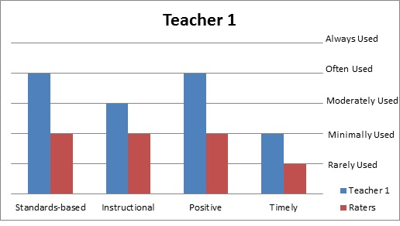
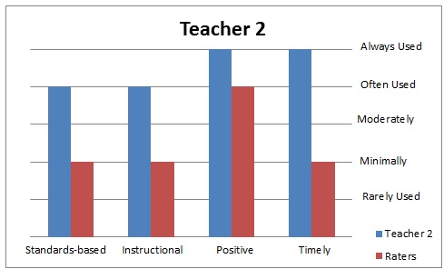
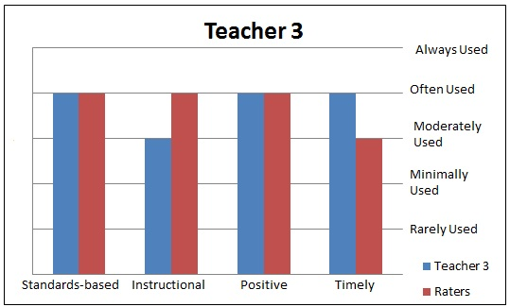
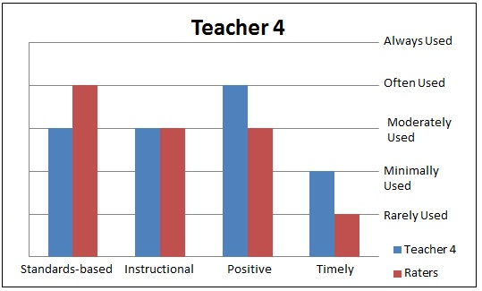
Teachers’ Overestimated Quality of Feedback

Slide 5
Teachers’ Failed to Provide Sufficient Feedback
Percentage of Unit 2 Assessments that Received Feedback
Teacher | Total number of Pieces of Feedback Provided to Treatment Students on Assessments from Unit 2 | Number of Pieces of Feedback Needed For All Treatment Students in Unit 2 | Percentage of Assessments in Unit 2 That Received Feedback
Teacher 1 | 5 | 72 | 7%
Teacher 2 | 17 | 82 | 21%
Teacher 3 | 20 | 50 | 40%
Teacher 4 | 6 | 47 | 13%

Slide 6
Student Achievement

Slide 7
Retention

Slide 8
Results

